Slide 1

KITTING DETAILED ANALYSIS
AGENDA
DB TABLES FIELD MAPPING
SEQUENCING PROGRAM
ORDER STATUS FLOW
EXCEPTIONS
MAIN DATABASE DESIGN
Ho Chi Minh, Sept 2016

Slide 2
DB TABLES FIELD MAPPING
Column | Description | Information | AS IS System
MAX CAP. | Line capacity (pcs/time) |  | Unknown ➔ Kitting Database: see Comment #1.
Top PO | Production Order |  | SAP
PO Qty | Qty to produce |  | SAP
Pack/Assy | Order progress (packing/assembly) | POs real time progress
Series | Unknown ➔ see comment #2. |  | Unknown ➔ Kitting Database: Process Team defined internally
TopModel | Material (P/N) |  | SAP
Shift | Production Shift
PO Online | Order status | Allowed Status list: Current PO/Next PO/Pending PO ➔ see Comment #3.
PlanRunOn | Schedule date | Schedule date (SAP); can be changed by Planners | SAP (?) ➔ see Comment #4.
WH Done | Order status (Warehouse) | Allowed Status list: Done/Pending CO/In Progress
WH Prep. At | Forecast for warehouse order completion ➔ see comment #5.
WH Fini At | Unknown ➔ see comment #6. |  | Unknown ➔ Kitting Database: see comment #7.
POCha. Inf | Unknown ➔ see comment #8. |  | Unknown ➔ Kitting Database: see comment #9.
Do It First, Make It Perfect Later

Slide 3
DB TABLES FIELD MAPPING(cont.)
Comment Items:
Comment #1 – Max Capacity Col. (pcs/shift): this capacity basing on the cycletime of products as set-up on SAP and controlled by Process team.
Comment #2 – Series Col.: this series value is controlled in database and following the product model number. It also called as product family
Note: as some discussion before about setting the layout of materials on workstations (for warehouse kitting materials to.); the Kitting system will consider product models which has same series/family; will have the same set-up of location materials on workstations. The grouping of product models into series/family will save time for Process team during setting up the layout of materials on workstation whenever one new product model instroduced to Production Planning.
New Production Model instroduced to Production Planning
Process Engineers setup Series for new Model
The Kitting system will learn from the same existing Series in database to lookup and fill new set-up of materials layout on workstations as is
Do It First, Make It Perfect Later

Slide 4
DB TABLES FIELD MAPPING(cont.)
Comment Items:
Comment #3 – PO Online Col.: in fact, the status of PO including 4 status:
1. Done PO
2. Current PO
3. Pending PO
4. Next PO
Because the Production Order in Production Planning will be done one-by-one (according to priority setup by Planners); so whenever one Production Order to be done (Done PO) ➔ the Next PO will become the Current PO in sequence and then; the Done PO will remove from Production Planning (in database where stores the Production Planning; the Done PO is still visible).
Do It First, Make It Perfect Later

Slide 5
DB TABLES FIELD MAPPING(cont.)
Comment Items:
Comment #4 – PlanRunOn and Shift Col.: two parameters will be calculated and initialized by Kitting program differently following two processes:
1. New Production Order is going to added into the spreadsheet of Production Planning:
➔ Two parameters are setup by Planners firstly basing on SAP; however still be in constraints with following factors:
- Max capacity per shift: this constraint prevent the planning over the capacity/shift or capacity/day. The kitting program will calculate the total quantity being present in the spreadsheet to move the Production Order to Next Shift (in case the Shift moving over the number of Shifts being scheduled for specific line)/or move Production Order to Next Day (in case the capacity is over the total of shifts availabel for last scheduled day in spreadsheet).
Note: - each Production Line has the limit of how many shift to be run per day
- 4 Shifts fixed for Warehouse to prepare materials: this prevent the Planners to change the Production Order/quantity,..which make warehouse to feed wrong Production Order/wrong quantity of PO,…
So that; whenever one new Production Order is going to added into the spreadsheet of Production Planning ➔ if there is any violation impacted to those constraints ➔ the Planners will change the priority of Production Order in Production Planning/or change the Schedule Day on SAP to satisfy the factory rule.
2. One Current PO becomes the Pending PO due to unplanned downtime: this pending PO will be moved to the another shift and date by calculation in Kitting prgoram ➔ see next slide.
Do It First, Make It Perfect Later

Slide 6
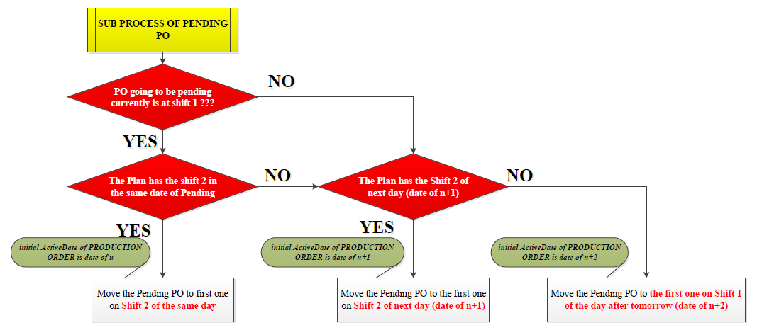
DB TABLES FIELD MAPPING(cont.)
Comment Items:
Exception For Pending PO:
- The Pending PO not follow the 4 Shifts fixed for Warehouse: it means Planners can change the order of Pending PO into the range of next 4 Shifts (being fixed for Next PO) ; because the materials of Pending PO is available (the Pending PO is Current PO/or Next PO which warehouse already prepared materials).
Do It First, Make It Perfect Later

Slide 7
DB TABLES FIELD MAPPING(cont.)
Comment Items:
Comment #5 – WH Prep. At Col. : this is not “Forecast for warehouse order completion”; this is the time when the System Controller (Kitting teams) release/print out the sheets of “Pulled List Materials” ➔ this is the time the Kitting teams starts preparing the materials for Production Order.
Comment #6 & #7 – WH Fini. At Col.: this is the time when the System Controller (Kitting teams) confirms the completion of materials preparation (all materials are prepared on trollies).
Comment #8 & #9 - PO Change Infor Col.: this column has two value of “YES” or “NO”. The “YES” value is shown when the Planners change the information of Production Order (ex.: change BOM due to ECO effective, Quantity change,…).
Do It First, Make It Perfect Later

Slide 8
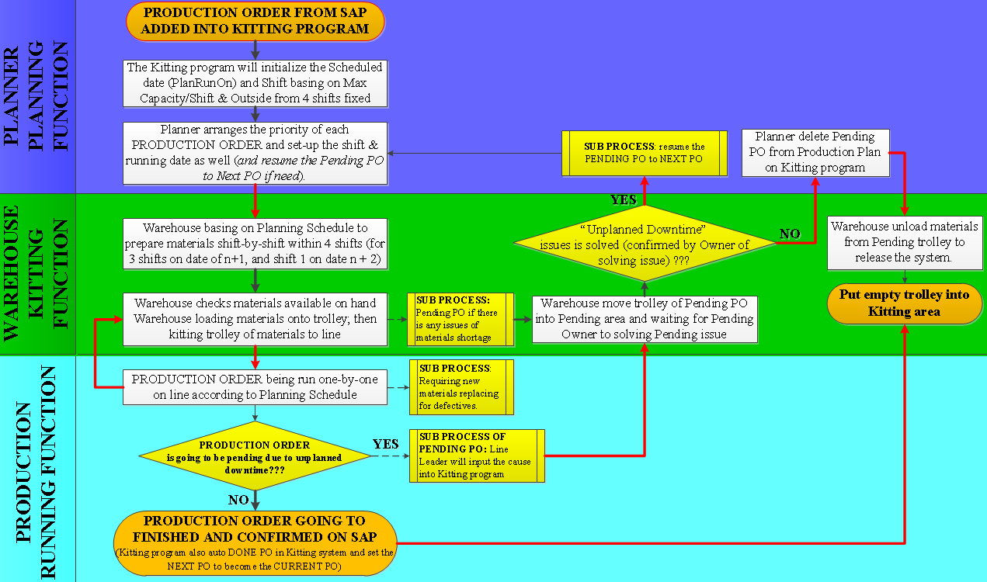
SEQUENCING PROGRAM
For video of simulating the whole process of adding Production Plan (Production Order) into the Kititng program ➔ Please refer to the link https://youtu.be/WXwmHtflmLE
Do It First, Make It Perfect Later

Slide 9
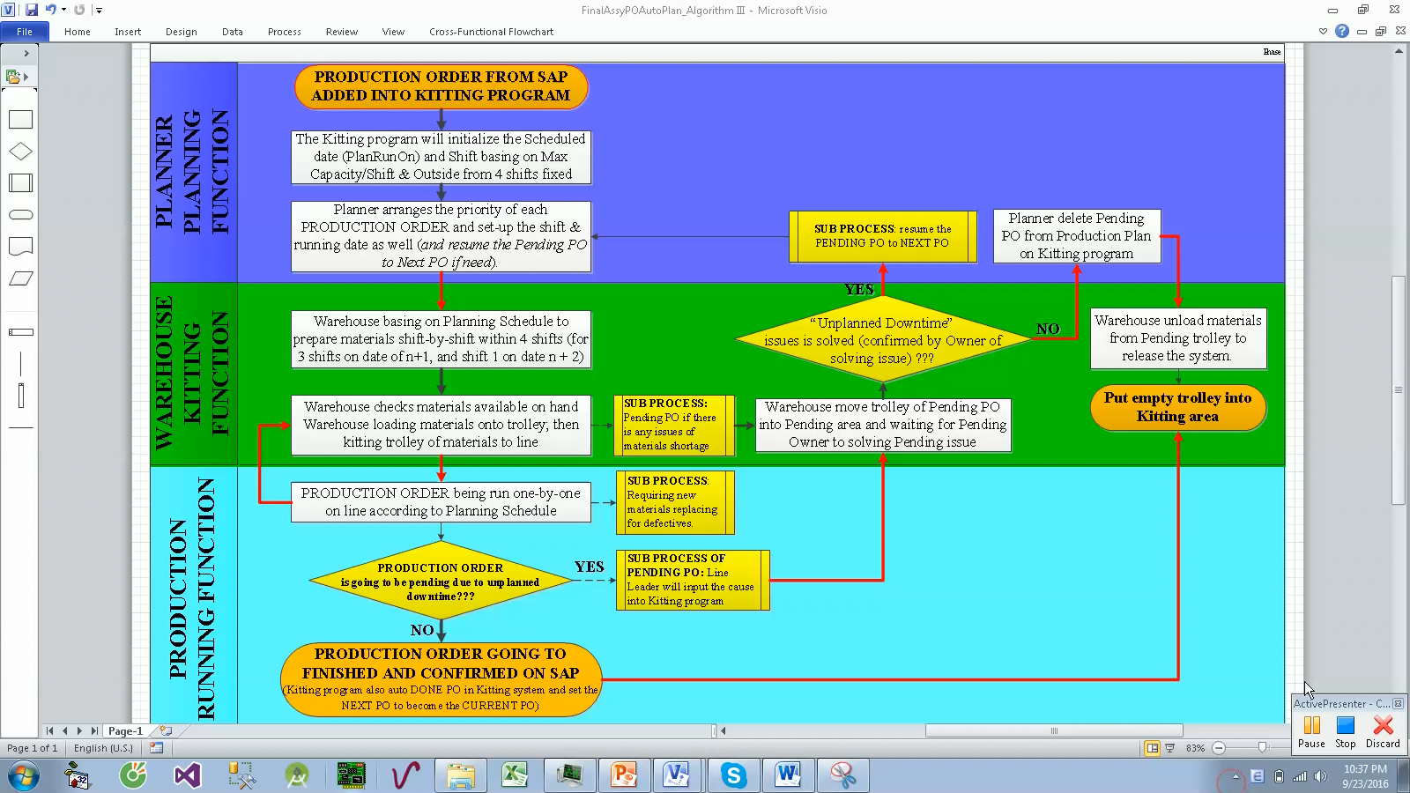
ORDER STATUS FLOW
This is video
Do It First, Make It Perfect Later

Slide 10
EXCEPTIONS
Sub Process Managed By Kitting Program
Add/View Planning Potential Pending Issues: Planners use this function to add warning so that Warehouse/Production have got awareness of shortage issues/potential issues when the concerned PO going to be prepared/run.
Register defective materials: Production uses this function to require new good part for replacing.
Pending PO: Production/Warehouse use this function to convert the Current PO/Next PO to Pending PO due to unplanned downtime issues.
Done PO: normally the Current PO on Kitting program’s spreadsheet will be done automatically (when Kitting program detect the quantity of packaged/or assembly to be equal to quantity of PO); however, there are some cases the Planners will reduce the quantity of PO ➔ then, line leader will Done PO manual by using this function.
Pull down the quantity package for upstream process of PCBA PostAssy Packaging: it means whenever the Planner update the Kitting database of Producton Planning ➔ the Kitting program will transfer this demand of base scanner to demand of PCBA PostAssy; this sub process will drive the PostAssy process to packaged according to demand/priority of base scanner.
Do It First, Make It Perfect Later

Slide 11
EXCEPTIONS
EXCEPTION CASES TO BE ADDRESSED
Exception For Pending PO: The Pending PO not follow the 4 Shifts fixed for Warehouse: it means Planners can change the order of Pending PO into the range of next 4 Shifts (which being fixed for Next PO) ; because the materials of Pending PO is available (the Pending PO is Current PO/or Next PO which warehouse already prepared materials).
In Kititng Program of Warehouse: the Kitting team can add any Production Order (all those PO must be present in current Kitting’s Production Plan) following any priority (not following the priority in currnet Kitting’s Production Plan) ➔ this function supports for some very urgent case of materials preparation (pushed by Global Planners,….).
Due to some urgent cases need interrupting the priority for Production Order already prepared materials: the normal process addresses that Plannners are not allowed to change information of Production Order (BOM, Quantity,…) when those Production Order drop into 4 Shifts fixed; however the Warehouse can unlock this rule so that the Planners can change information of Production Order.
➔ Note: the unlock function of breaking the normal rule following process:
- It is only for warehouse’s usage (no one can use this function.)
- It is lock/unlock according to Planner’s username (in Kitting’s Database).
- It will be resumed after the next time Warehouse do pulled list of materials.
Do It First, Make It Perfect Later

Slide 12
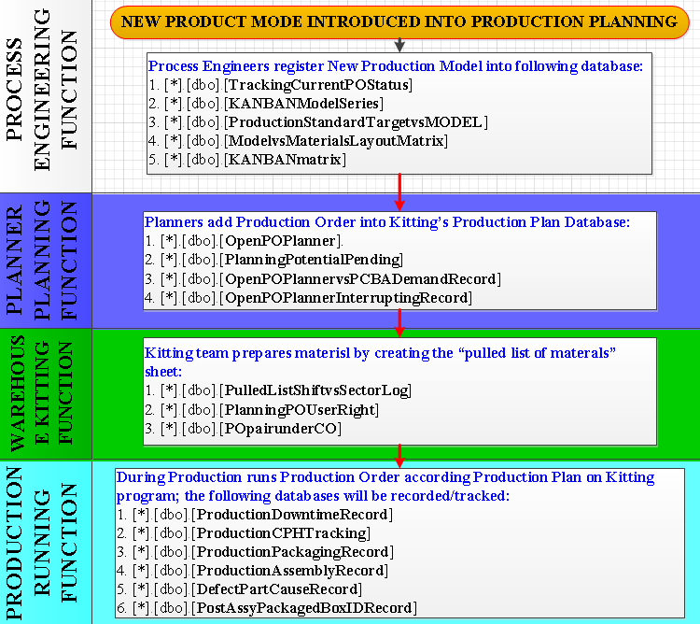
MAIN DATABASE DESIGN
Note: those database shown here are main database only.
Do It First, Make It Perfect Later

Slide 13
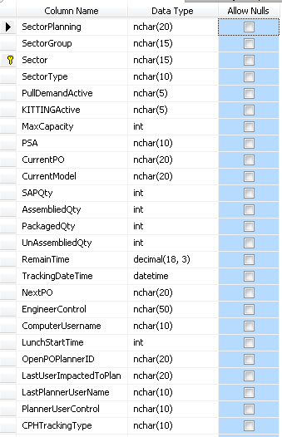
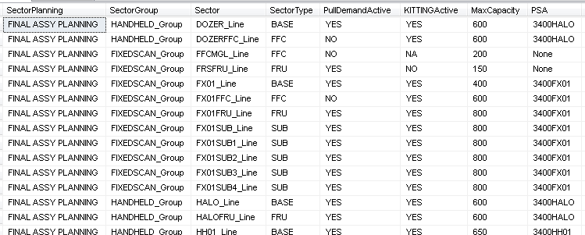
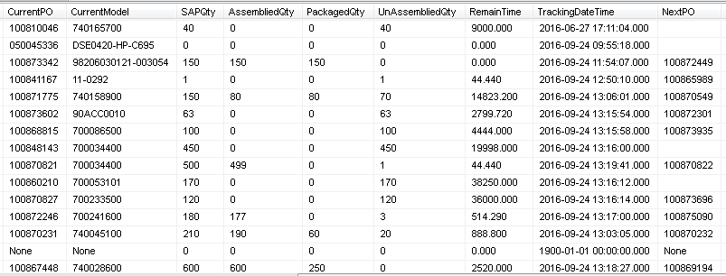
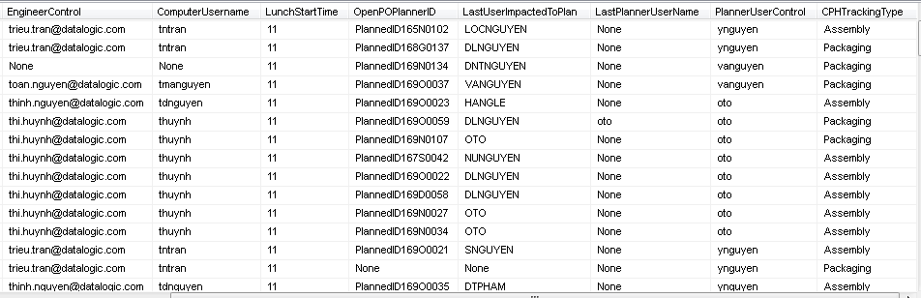
MAIN DATABASE DESIGN (cont.)
PROCESS ENGINEERING FUNCTION – SETUP DATBASE
[*].[dbo].[TrackingCurrentPOStatus] - the database containts the following information:
- The information of lines being present on Production floor.
Some key information of Current PO running on the lines.
Planners are responsible for lines
Do It First, Make It Perfect Later

Slide 14
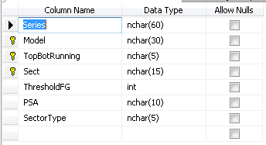
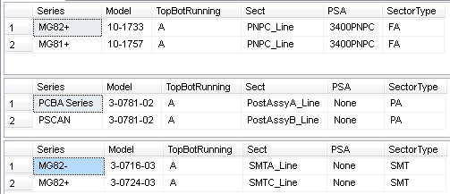
MAIN DATABASE DESIGN (cont.)
PROCESS ENGINEERING FUNCTION – SETUP DATBASE
[*].[dbo].[KANBANModelSeries] - the database containts the following information:
- The main information of Product Model: which line will be run.
Do It First, Make It Perfect Later

Slide 15
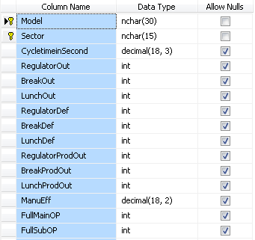
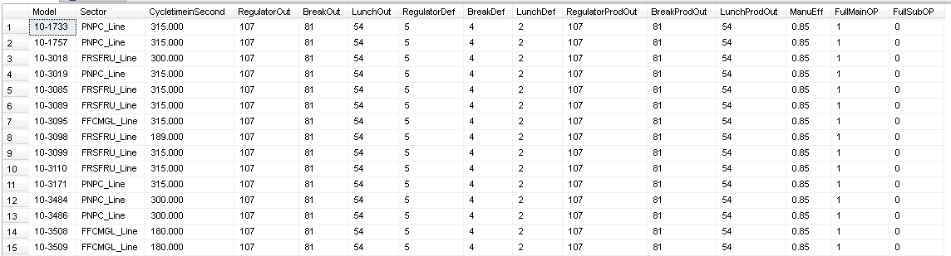
MAIN DATABASE DESIGN (cont.)
PROCESS ENGINEERING FUNCTION – SETUP DATBASE
[*].[dbo].[ProductionStandardTargetvsMODEL] - the database containts the following information:
- The product model’s cycletime + target output + No. of main operators + No. sub operators.
Do It First, Make It Perfect Later

Slide 16
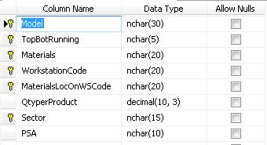
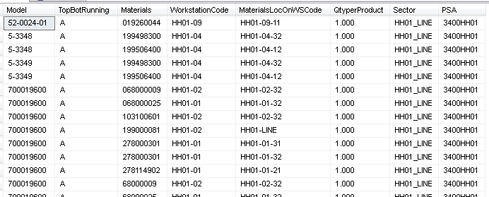
MAIN DATABASE DESIGN (cont.)
PROCESS ENGINEERING FUNCTION – SETUP DATBASE
[*].[dbo].[ModelvsMaterialsLayoutMatrix] - the database containts the following information:
- The location of materials set-up on line where Kitting team will feed materials to
Do It First, Make It Perfect Later

Slide 17
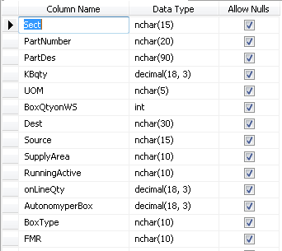
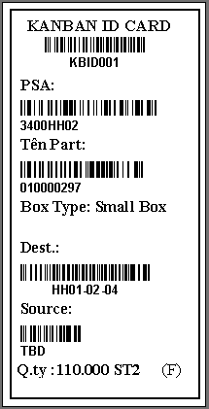
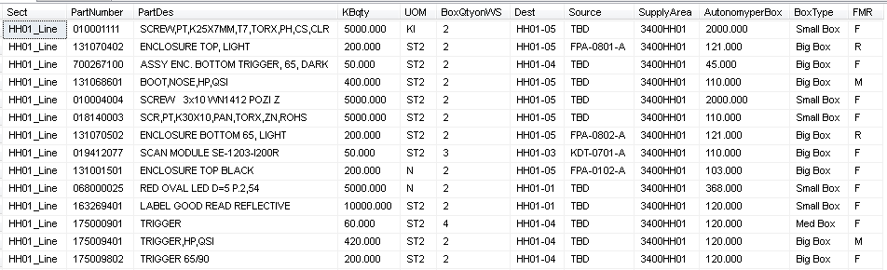
MAIN DATABASE DESIGN (cont.)
PROCESS ENGINEERING FUNCTION – SETUP DATBASE
[*].[dbo].[KANBANmatrix] - the database containts the following information:
- The information of KANBAN cards are set-up versus the materials number
Do It First, Make It Perfect Later

Slide 18
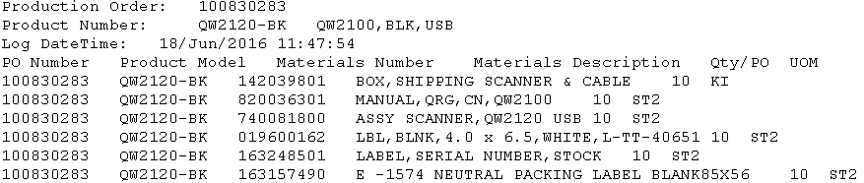
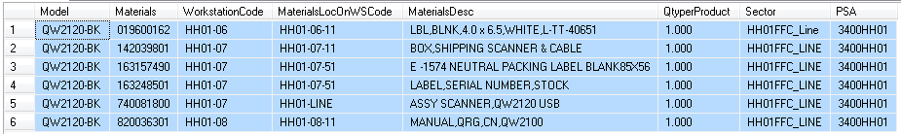
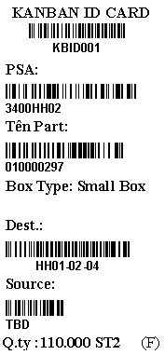
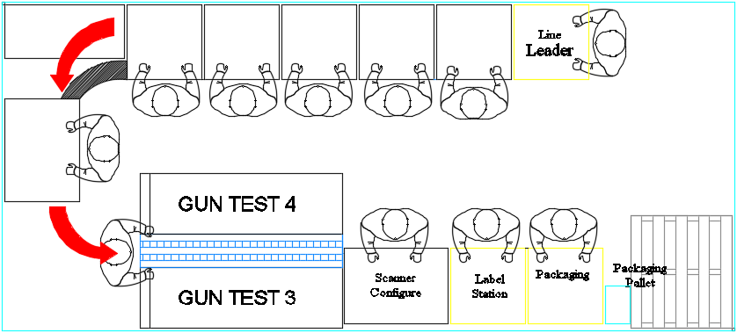

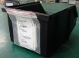
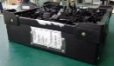
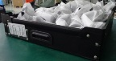
MAIN DATABASE DESIGN (cont.)
PROCESS ENGINEERING FUNCTION – SETUP DATBASE
QW2120-BK Kitting Materials Layout Mapping & Simulation
- BOM on SAP follows Production Order: each Production Order’s BOM is pulled out from SAP and logged into local folder every time Planners input Production Order into Kitting program
- “Location of Materials On Line” Database: all materials of production order follows with Model number are mapped to locations on line (set up by Product Engineers)
Warehouse Kitting team will prepares materials kanban boxes with KANBAN cards attached to each box; so that they can know exactly where they should feed materials to.
Note:
there is a software to help to print out the KANBAN box cards when the Kitting teams make a pulled list of materials
There is also one database to control which box type the KANBAN box of materials should be (small/medium/big box).
6
7
8
Do It First, Make It Perfect Later

Slide 19
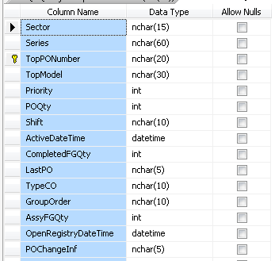
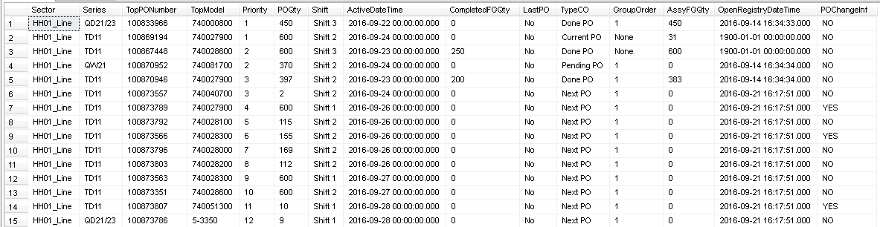
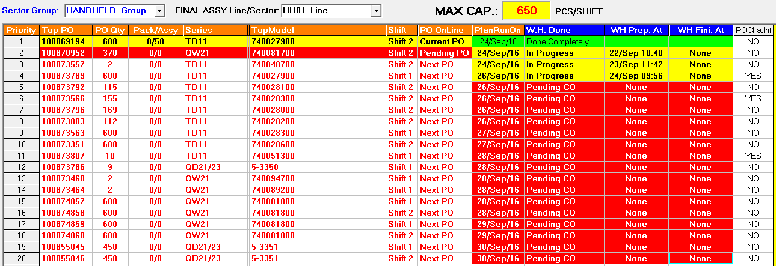
MAIN DATABASE DESIGN (cont.)
PLANNER PLANNING FUNCTION – RUNNING DATBASE
[*].[dbo].[OpenPOPlanner] - the database containts the following information: the database will capture Final Assy Scheduled Plan inputted by Planner, this database is also updated realtime to tracking the status of Production Order (Current PO, Next PO, Done PO & Pending PO) ➔ this database is Production Plan shown on Kitting program’s
Do It First, Make It Perfect Later

Slide 20
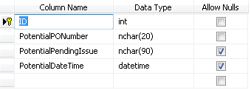
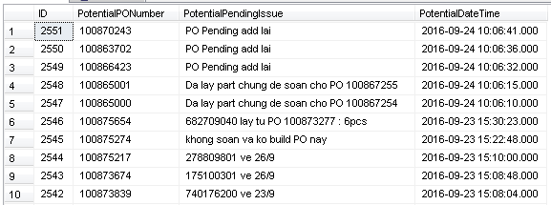
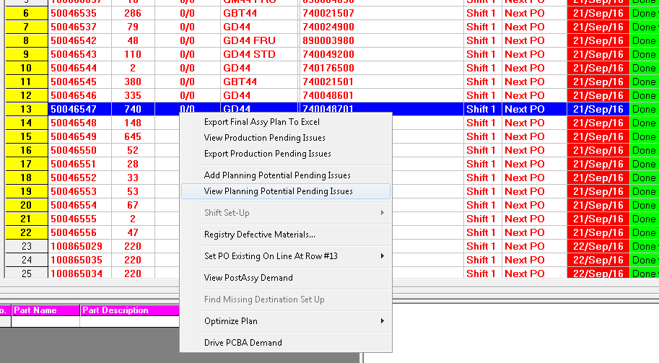
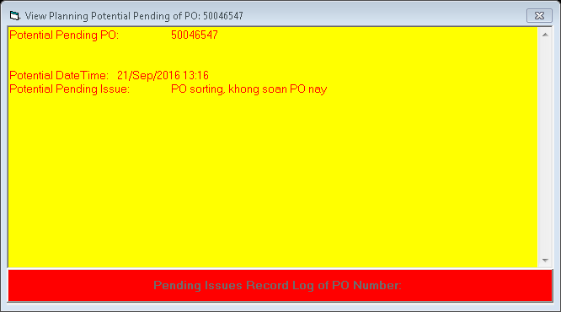
MAIN DATABASE DESIGN (cont.)
PLANNER PLANNING FUNCTION – RUNNING DATBASE
[*].[dbo].[PlanningPotentialPending] - ]: the database will capture Potential Pending Issues noticed by Planner.
Do It First, Make It Perfect Later

Slide 21
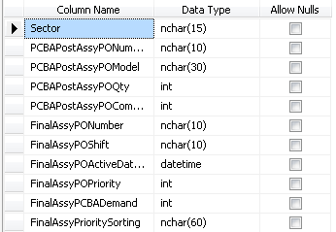
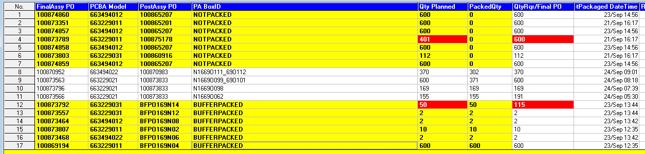
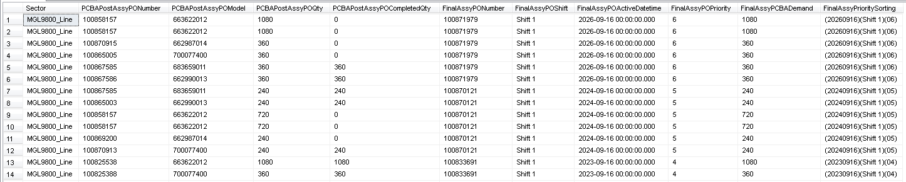
MAIN DATABASE DESIGN (cont.)
PLANNER PLANNING FUNCTION – RUNNING DATBASE
[*].[dbo].[OpenPOPlannervsPCBADemandRecord]: this database captures all PCBA demand pulled down from demand of Final Assy Scheduled Plan ➔ those demands will drive the PostAssy process to packaged according to demand/priority of base scanner.
Do It First, Make It Perfect Later

Slide 22
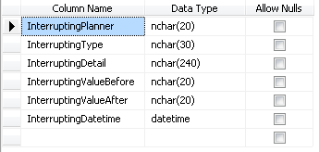
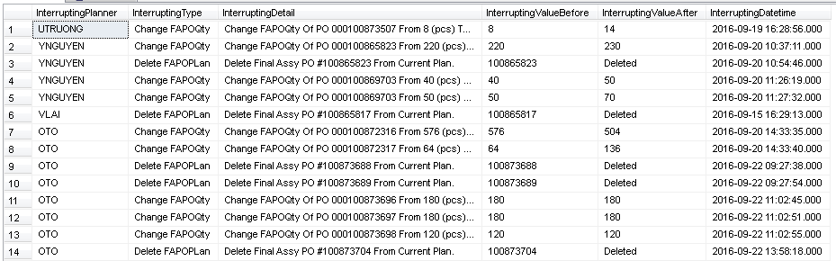
MAIN DATABASE DESIGN (cont.)
PLANNER PLANNING FUNCTION – RUNNING DATBASE
[*].[dbo].[OpenPOPlannerInterruptingRecord]: this database captures all actions which Planners do to change the information of Production Order on Kitting’s Production Plans after loading/updating into Kitting’s database
Do It First, Make It Perfect Later

Slide 23
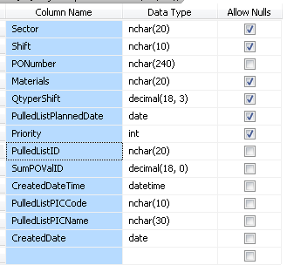
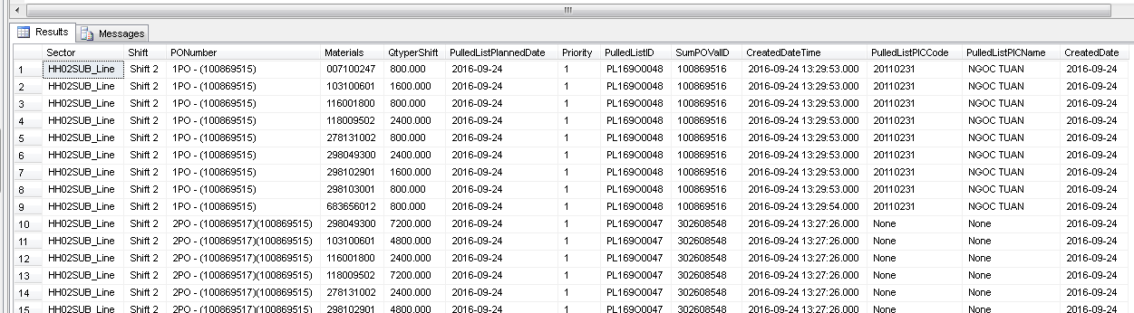
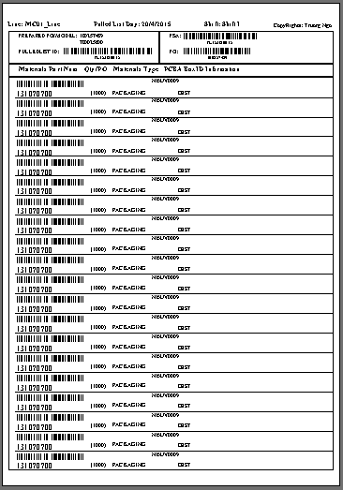
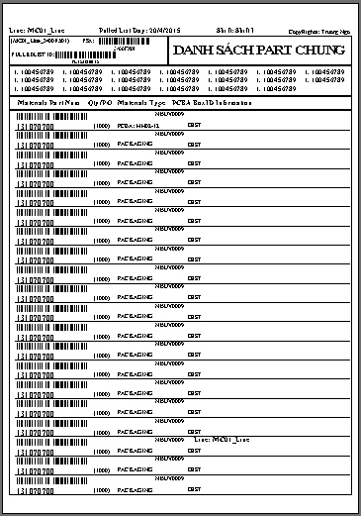
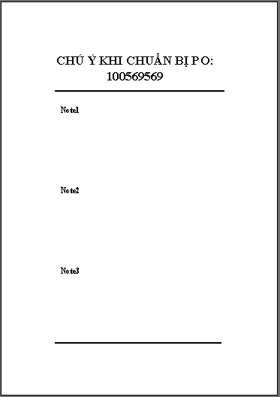
MAIN DATABASE DESIGN (cont.)
WAREHOUSE KITTING FUNCTION – RUNNING DATBASE
[*].[dbo].[PulledListShiftvsSectorLog]: this database captures the list of materials after Warehouse teams do pulled list of materials/prepare the materials list.
Do It First, Make It Perfect Later

Slide 24
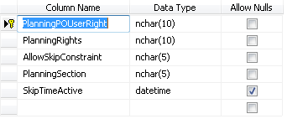
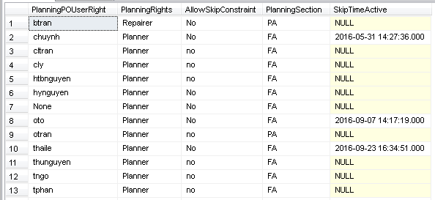
MAIN DATABASE DESIGN (cont.)
WAREHOUSE KITTING FUNCTION – RUNNING DATBASE
[*].[dbo].[PlanningPOUserRight]: this database control the unlock function to allow/or not allow Planner to breake the normal rule following process to add/modify the Production Plan in Kitting’s database for urgent case
Do It First, Make It Perfect Later

Slide 25
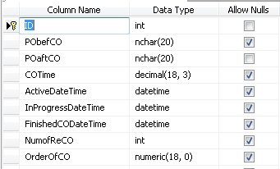
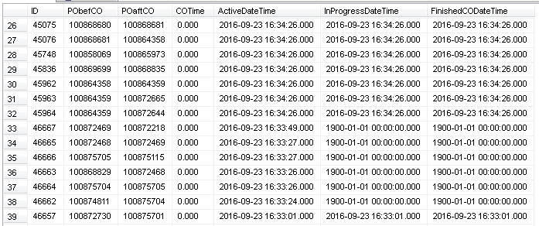
MAIN DATABASE DESIGN (cont.)
WAREHOUSE KITTING FUNCTION – RUNNING DATBASE
[*].[dbo].[POpairunderCO]: this database captures/tracking the progress of preparing materials at Warehouse.
Do It First, Make It Perfect Later

Slide 26
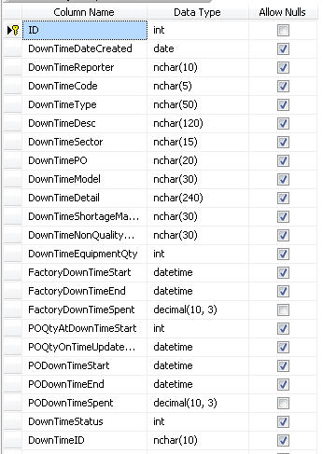
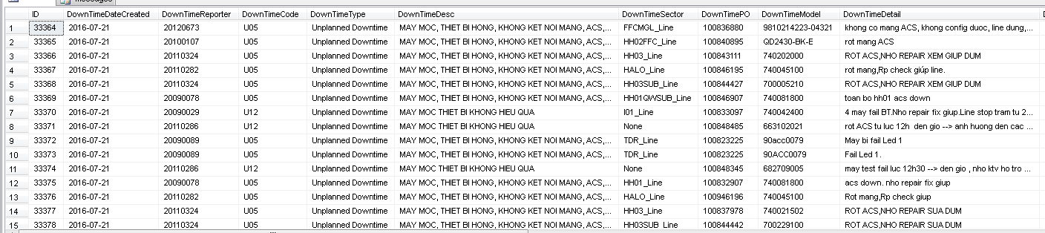
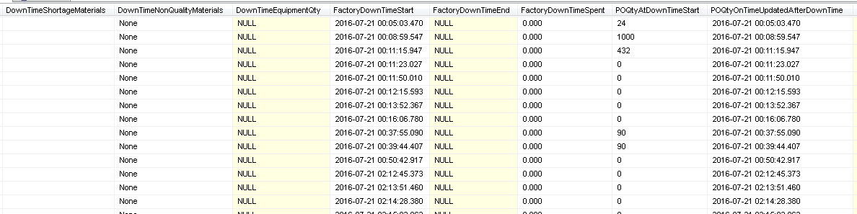
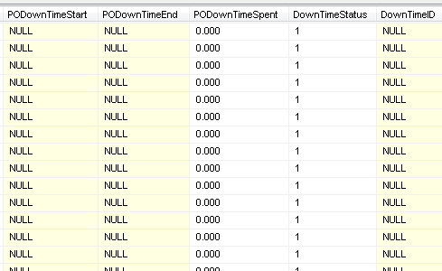
MAIN DATABASE DESIGN (cont.)
PRODUCTION RUNNING FUNCTION – RUNNING DATBASE
[*].[dbo].[ProductionDowntimeRecord]: this database captures the issues cause Production Order going to be pending from Production Plan.
Do It First, Make It Perfect Later

Slide 27
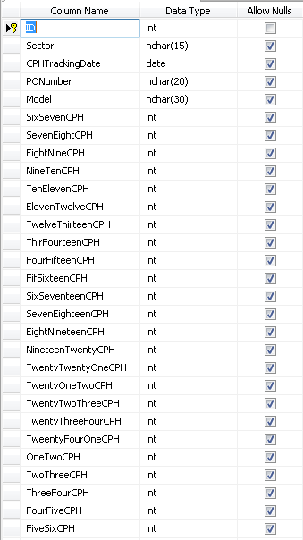

MAIN DATABASE DESIGN (cont.)
PRODUCTION RUNNING FUNCTION – RUNNING DATBASE
[*].[dbo].[ProductionCPHTracking]: this database captures/tracking the capacity according to Production Order
Do It First, Make It Perfect Later

Slide 28


MAIN DATABASE DESIGN (cont.)
PRODUCTION RUNNING FUNCTION – RUNNING DATBASE
[*].[dbo].[ProductionPackagingRecord]: this database captures/tracking the information of products being packaged on production lines.
Do It First, Make It Perfect Later

Slide 29


MAIN DATABASE DESIGN (cont.)
PRODUCTION RUNNING FUNCTION – RUNNING DATBASE
[*].[dbo].[ProductionAssemblyRecord]: this database captures/tracking the information of products being assemblied on production lines.
Do It First, Make It Perfect Later

Slide 30


MAIN DATABASE DESIGN (cont.)
PRODUCTION RUNNING FUNCTION – RUNNING DATBASE
[*].[dbo].[DefecdtPartCaurseRecord]: this database captures/tracking the require new good part for replacing defectives.
Do It First, Make It Perfect Later

Slide 31



MAIN DATABASE DESIGN (cont.)
PRODUCTION RUNNING FUNCTION – RUNNING DATBASE
[*].[dbo].[PostAssyPackagedBoxIDRecord]: this database captures/tracking demand of PostAssy process to packaged according to demand/priority of base scanner.
Do It First, Make It Perfect Later

Slide 32
Thank you

